Slide 1
Python Programming
Session – 01
Setting up Environment

Slide 2
Installing Python
Python lets you work more quickly and integrate your systems more effectively.

Slide 3

Download and Installing Python
Skip this if you are installing Anaconda
Download and Install the Python as instructed by the python.org for your platform.
https://www.python.org/downloads/
Python Version for this Course is: 3.7.2

Slide 4
Installing Anaconda
The World’s Most Popular Python Data Science Distribution

Slide 5


Download and Installing Anaconda
Download and Install the Anaconda for your specific platform.
https://www.anaconda.com/distribution/#download-section
Anaconda Version for this Course is: 2018.12 Python 3.7 Version

Slide 6
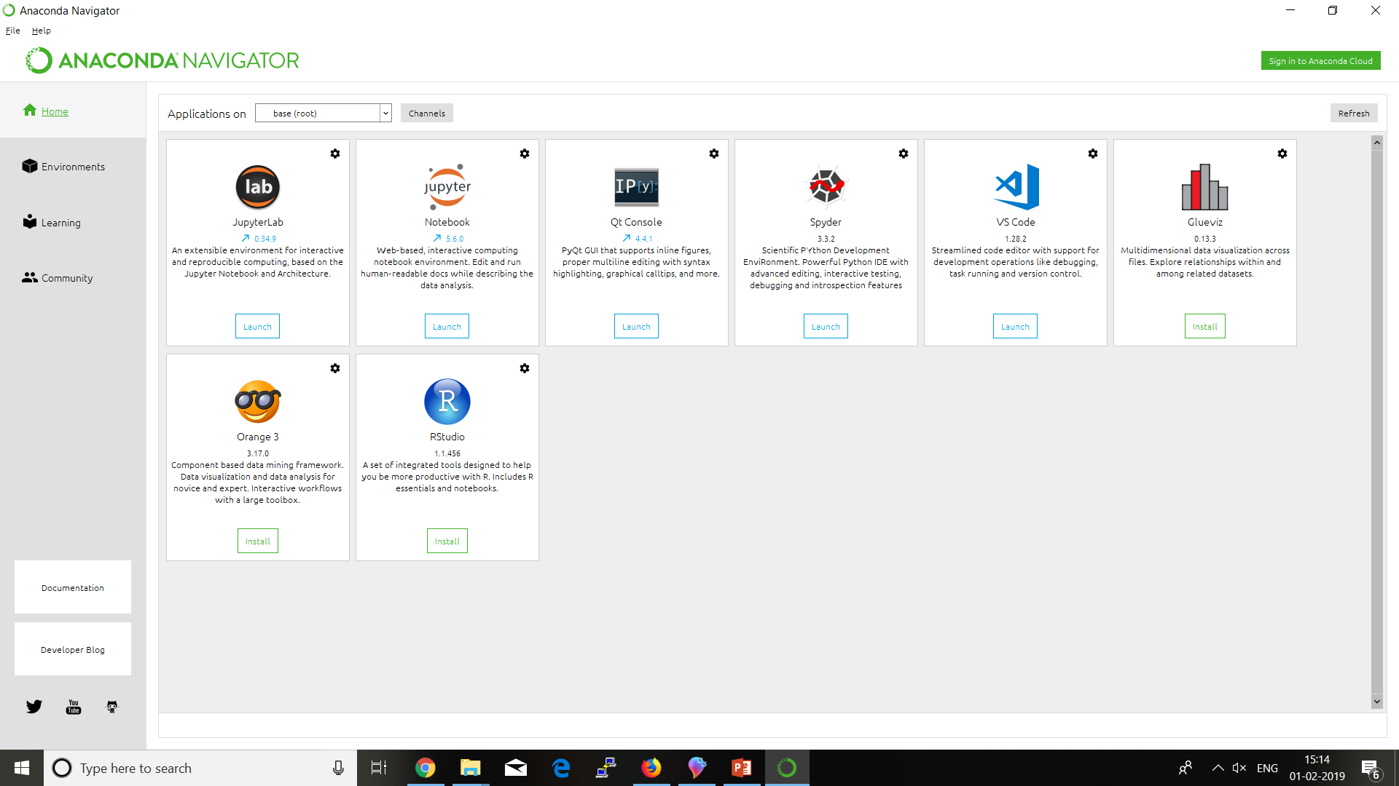
Anaconda Walkthrough

Slide 7
Installing jupyter
Jupyter Produces Rich and Interactive Output

Slide 8


Anaconda > Jupyter
Jupyter Notebook allows you to create and share documents that contain live code, equations, visualizations and narrative text.
Jupyter website strongly recommends installing Python and Jupyter using the Anaconda Distribution
Use this button to Install or Launch jupyter notebook

Slide 9
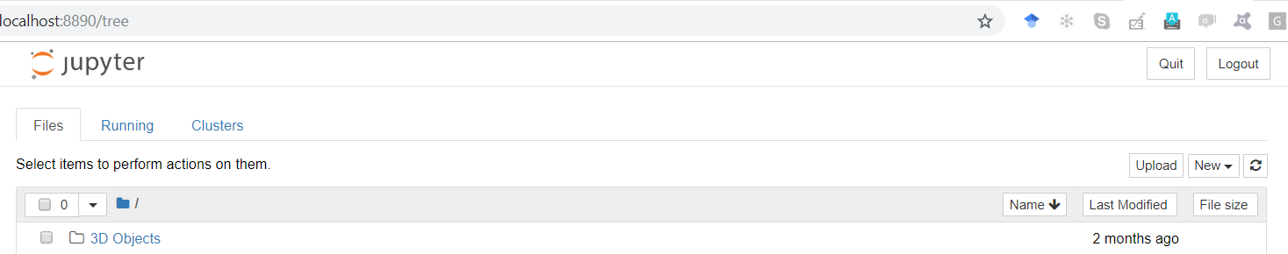
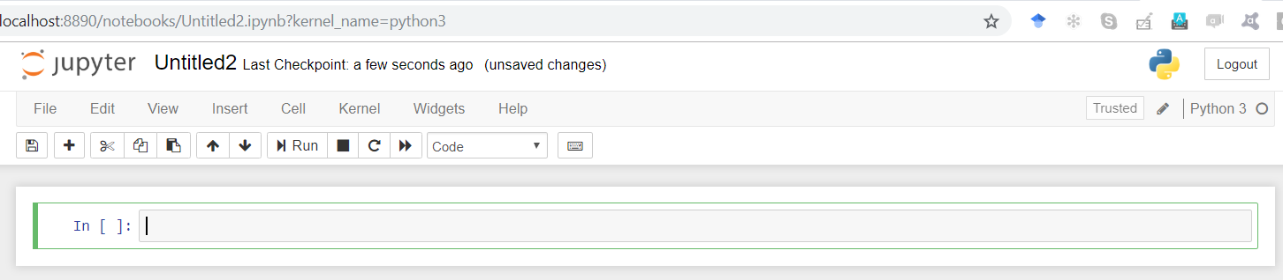
Jupyter Walkthrough

Slide 10
Installing SPYDer
Spyder offers built-in integration with many popular scientific packages

Slide 11
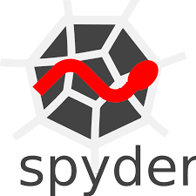

Anaconda > Spyder
Spyder is a powerful scientific environment written in Python, for Python, and designed by and for scientists, engineers and data analysts..
It features a unique combination of the advanced editing, analysis, debugging and profiling functionality
Use this button to Install or Launch spyder

Slide 12
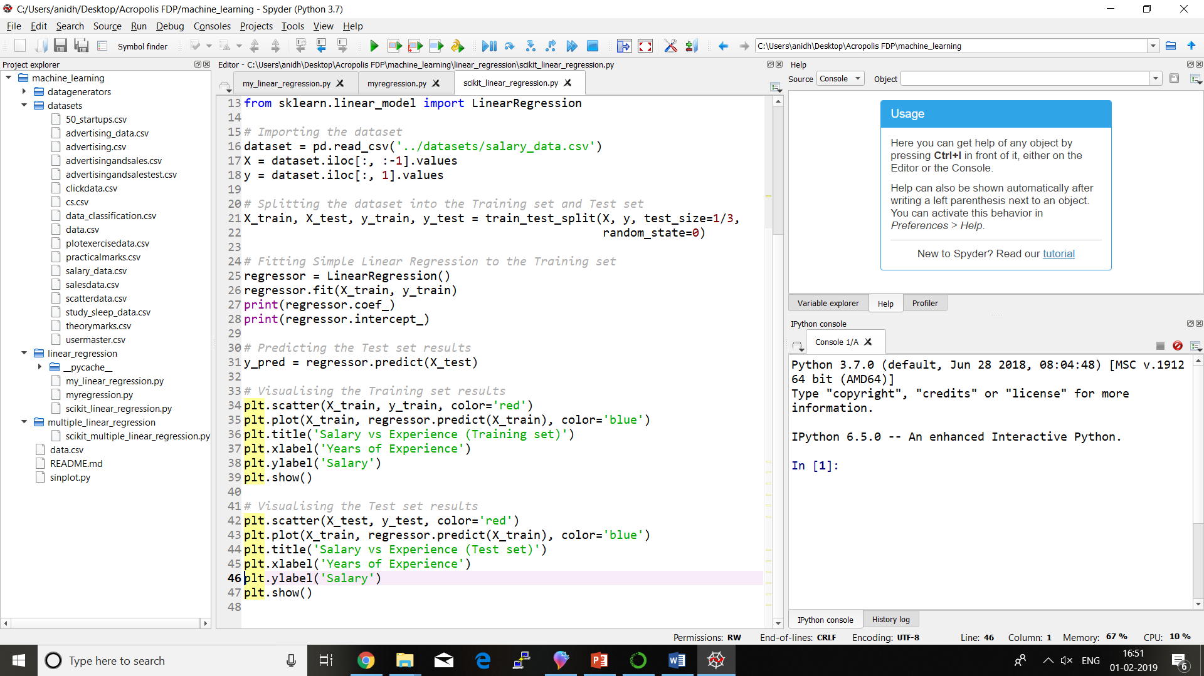
Spyder Walkthrough
Run Program
Help Docs
Variable Explorer
Project
Explorer
File Editor
Ipython Console
History Log

Slide 13
Installing PyCharm
The IDE for Professional Developers

Slide 14

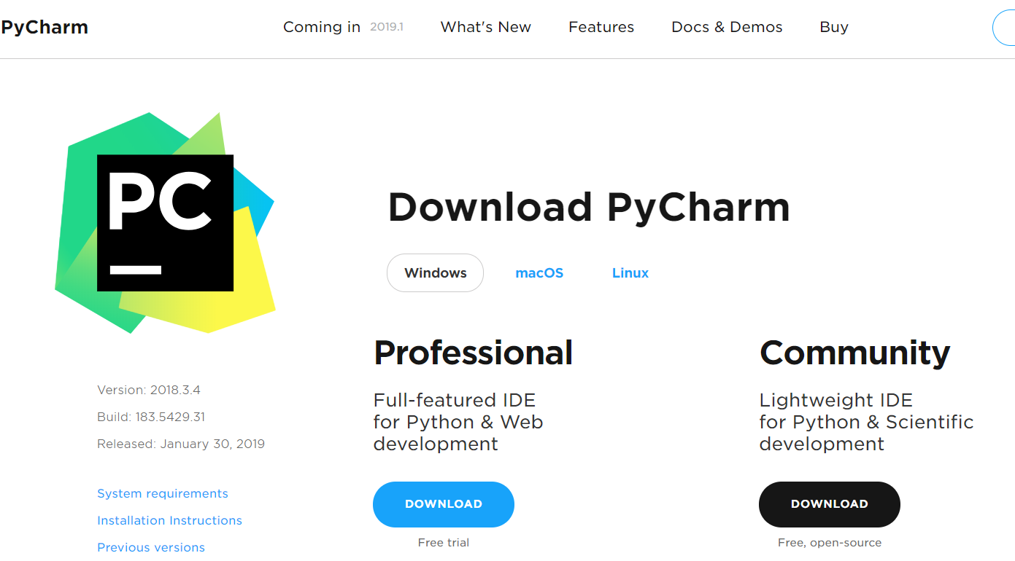
JetBrains PyCharm
https://www.jetbrains.com/pycharm/download/#section=windows
PyCharm provides smart code completion, code inspections, on-the-fly error highlighting and quick-fixes, along with automated code re-factorings and rich navigation capabilities.
PyCharm integrates with IPython Notebook, has an interactive Python console, and supports Anaconda as well as multiple scientific packages including Matplotlib and NumPy.
Download and Install Community Version Compatible with your OS

Slide 15
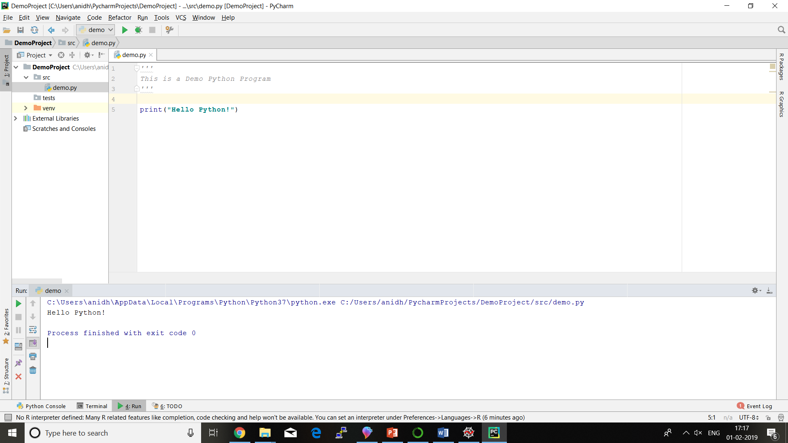
PyCharm Walkthrough
Run Program
Source File
Editor
Project
Explorer
Python Console, Terminal, Output and TODO

Slide 16
Create your learning environment
Create Directories and Projects to House your Source Files

Slide 17
Learning Environment
Create your Git Repository for <YourName>PythonLearning
Clone it to a folder in your System
Create 11 directories with name as "Module-01" to "Module-11" and two directories with name "Module-TDD" and "Module-LogicBuilding".
Now Commit your Changes and Push it to your git repository.
Git Commands
> git clone https://github.com/<your_github_id>/<repository_name>.git
> git add –A
> git commit –m "your commit message"
> git push

Slide 18
Create your Assignment environment
Create Directories and Projects to House your Source Files for Assignments and Projects

Slide 19
Assignment Environment
Create your Git Repository for <YourName>PythonAssignments
Clone it to a folder in your System
Create 1 directory with name as "Demo".
Now Commit your Changes and Push it to your git repository.
Git Commands
> git clone https://github.com/<your_github_id>/<repository_name>.git
> git add –A
> git commit –m "your commit message"
> git push

Slide 20
Exercise – 1
Setup Exercise

Slide 21
Setup Exercise
Setup the complete environment on your system as well as on the git repository.
Create a directory with the name "img" in Demo directory of PythonAssignment.
Now take the screenshots of your installations and save the images as jpg format in the "img" folder you just created.
Commit and push it to your Git Repository.

Slide 22
Next Session
Secret Sauce by Top Programmers

